Slide 1
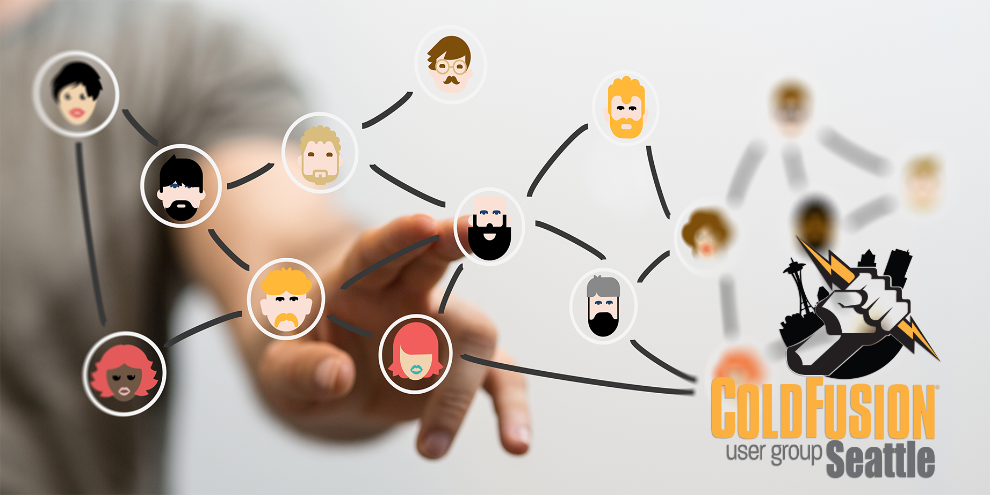
November 2019

Slide 2
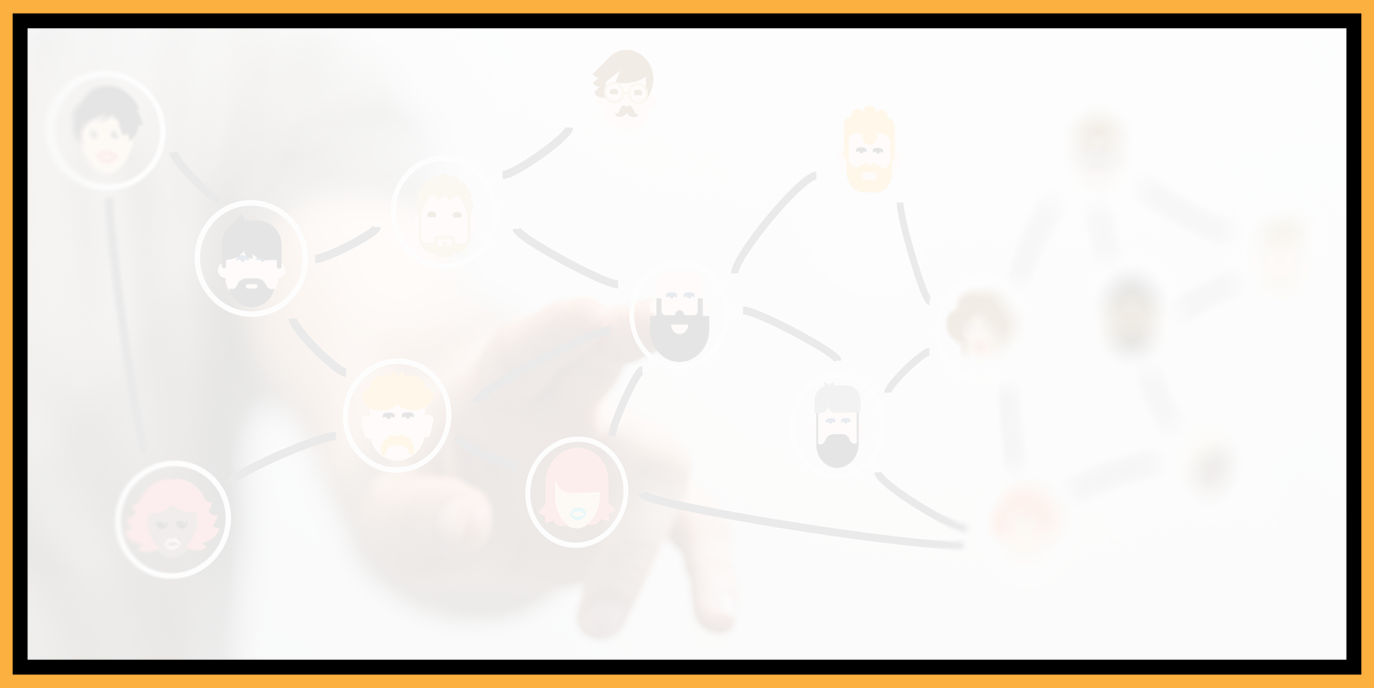
Agenda
Introductions
Goals
Add Your Bio to the Seattle CFUG site
Adobe ColdFusion Breakfast Meetup
Using Adobe ColdFusion Builder 2018 to Debug your ColdFusion Application
Next Meeting
Questions/Answers/Help Needed

Slide 3
Introductions
Tell us a little bit about who you are
Share with us what you would like to get from this user group

Slide 4
Goals
Assist ColdFusion Developers Throughout the Pacific Northwest
Promote ColdFusion Developers Throughout the Pacific Northwest
Connect Employers with ColdFusion Developers
Establish a Community of Friendship Between ColdFusion Developers
Provide Speaking Opportunities for ColdFusion Developers
Change the Perception of ColdFusion as a viable platform

Slide 5
Add Your Bio to the Seattle ColdFusion User Group site
Let prospective employers know you’re available for ColdFusion Support
Include your photo, biography, social media links and e-mail address
Available for any active Seattle ColdFusion User Group member (attendance at a Seattle ColdFusion User Group Meeting in the past 3 months). Don’t need to be a resident in the Pacific Northwest,

Slide 6
Adobe ColdFusion Breakfast Meetup
November 20, 2019 8:30 am – 11:30 am
Courtyard Portland City Center
550 SW Oak Street, Portland, OR 97204
Register at https://coldfusion-roadshows.meetus.adobeevents.com/

Slide 7
Using Adobe ColdFusion Builder 2018 to Debug your ColdFusion Application
Vinay Jindal – Senior ColdFusion Engineer - Vancouver BC
e-mail: jindalvinay@gmail.com

Slide 8

Why Debug ?
To find bugs or defects
To reproduce the conditions in which error has occurred
Try to get all the variable values and states of the program at that time
Vinay Jindal – Senior ColdFusion Engineer - Vancouver BC

Slide 9
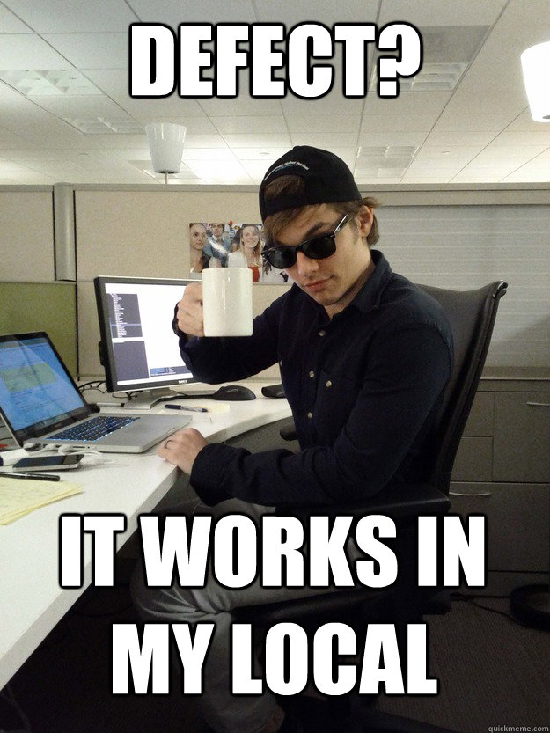
How do you Debug ?
cfoutput
cfdump
Do you know that we have ColdFusion Debugger to the rescue
Vinay Jindal – Senior ColdFusion Engineer - Vancouver BC

Slide 10
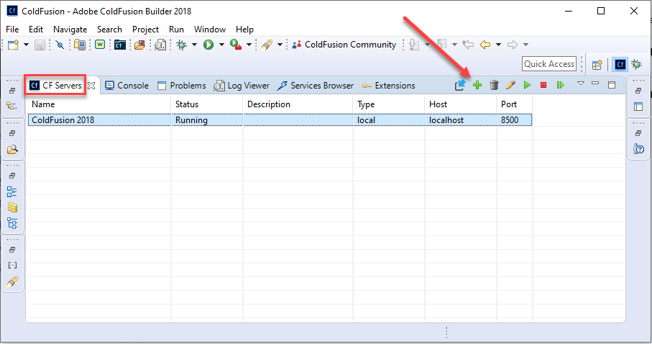
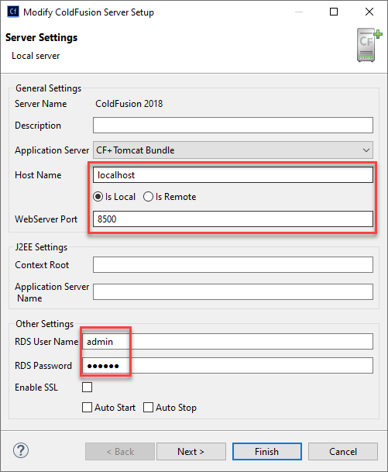
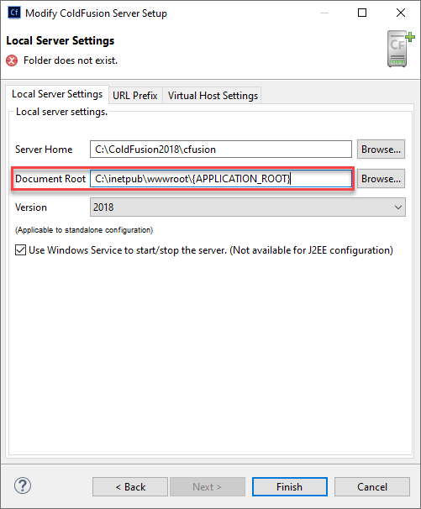
Adobe ColdFusion Builder 2018 - Setup

Slide 11

Using Adobe ColdFusion Builder 2018 to Debug your ColdFusion Application

Slide 12
Next Meeting
January 15th or 22th, 2020 – 6:00 PM PST for in-person attendees; 6:30 PM PST for everyone (on-line attendees via Zoom).

